Slide 1
PORTFOLIO PROJECT
76,580
2024 — 2025
FoodMart
Retail Chain
Daily Transaction Records
19,262
Total Stockout Events
Demand Forecasting
& Inventory Planning
86%
Supplier Delay Rate
₦13.3B+
Total Revenue Analysed
Ibadan, Nigeria | 7 Stores | 20 Products | 18 Months
Olajimi Adeleke | PostgreSQL & Python

Slide 2
Project Overview
ABOUT THIS PROJECT
Demand & Sales Analysis
Inventory Risk
FoodMart operates seven supermarket branches across Ibadan, Nigeria. This project analyses 18 months of transaction data to understand demand behaviour, pinpoint stockout patterns, evaluate supplier reliability, and identify perishable inventory waste risks.
The findings form the foundation for forecasting models and data-driven replenishment decisions.
Replenishment Efficiency
Supplier Performance
Expiry & Waste
Demand Trend Analysis
6 Analysis Sections
Tool Stack:
PostgreSQL Python (pandas, matplotlib, statsmodels, Prophet) 18 months of data

Slide 3
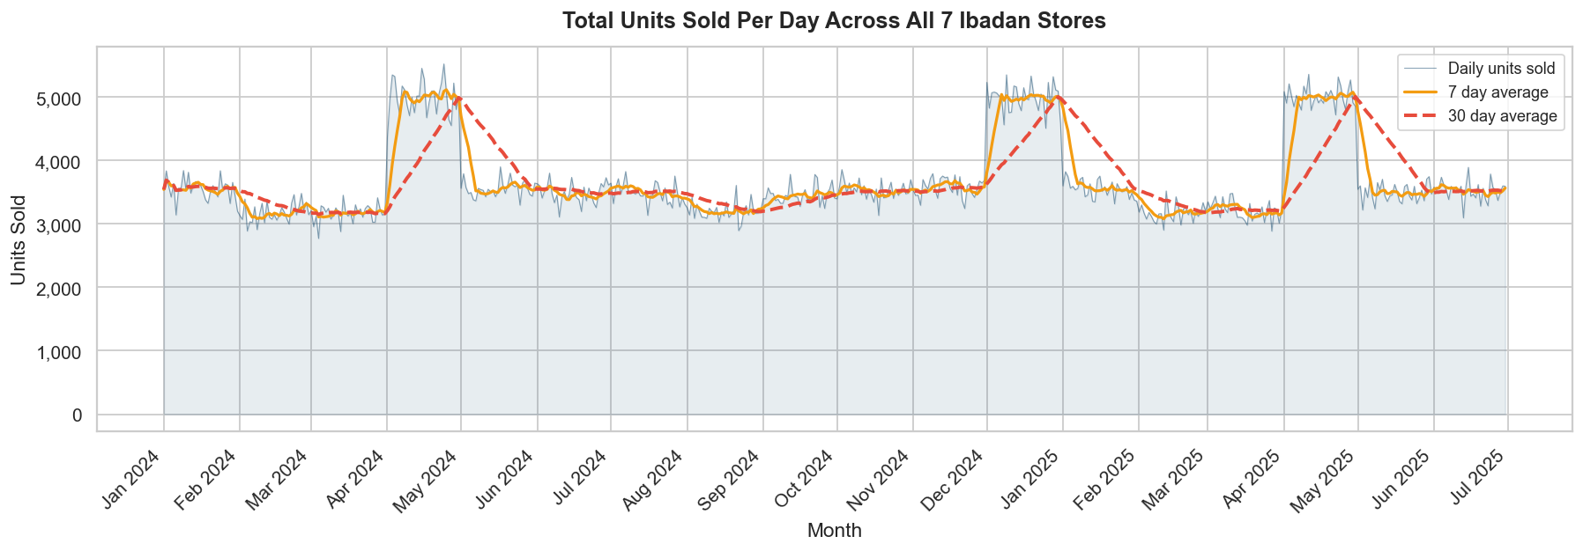
Demand Trend Analysis
Stable Baseline
April Surge
December Peak
3,200 to 3,800 units per day outside seasonal windows
Sales spike to 5,000+ units driven by Easter and Eid seasons
Year-end festive period produces a second major demand spike

Slide 4
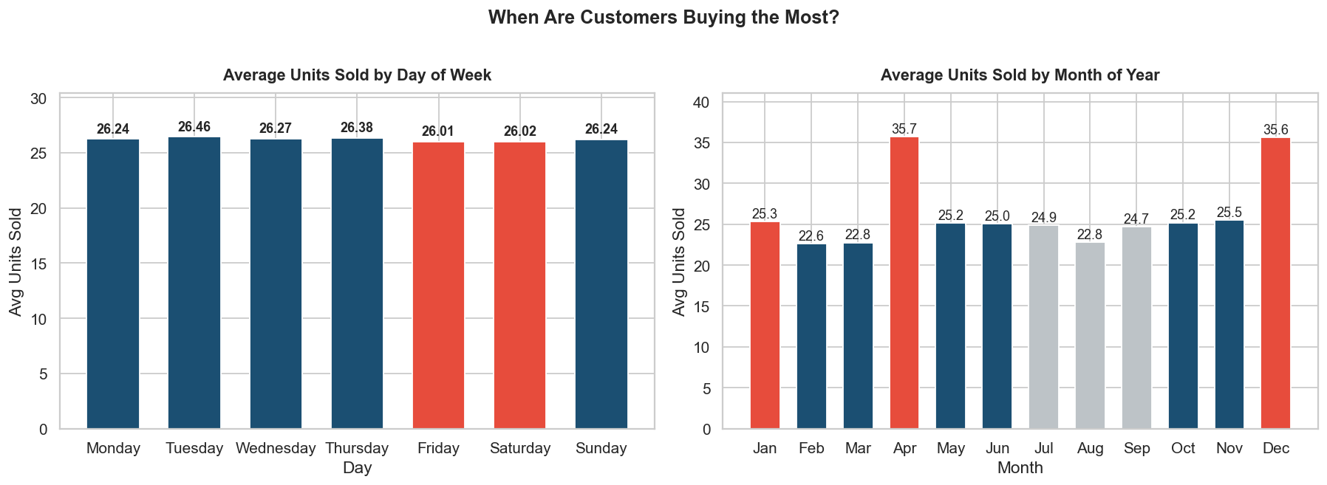
Weekly & Monthly Demand Patterns
Flat Daily Pattern
April & December Dominate
Daily demand varies by less than 0.5 units on average. No single shopping day dominates, which simplifies weekday replenishment planning.
Both months average 35+ units per day versus 22 to 25 units in low months. Seasonal uplift is entirely calendar-driven.

Slide 5
Top Products & Demand Volatility
#1
#2
#3
Bread
Indomie
Noodles
Rice
142,542 units sold
141,675 units sold
140,280 units sold
₦1.12B revenue
₦1.56B revenue
₦594M revenue
Bakery
Food
Food
DEMAND VARIABILITY BY CATEGORY
Food
59.2%
Frozen Foods
56.8%
Snacks
56.5%
Bakery
52.7%
Every category exceeds 50% demand variability, making simple average-based forecasting unreliable.

Slide 6
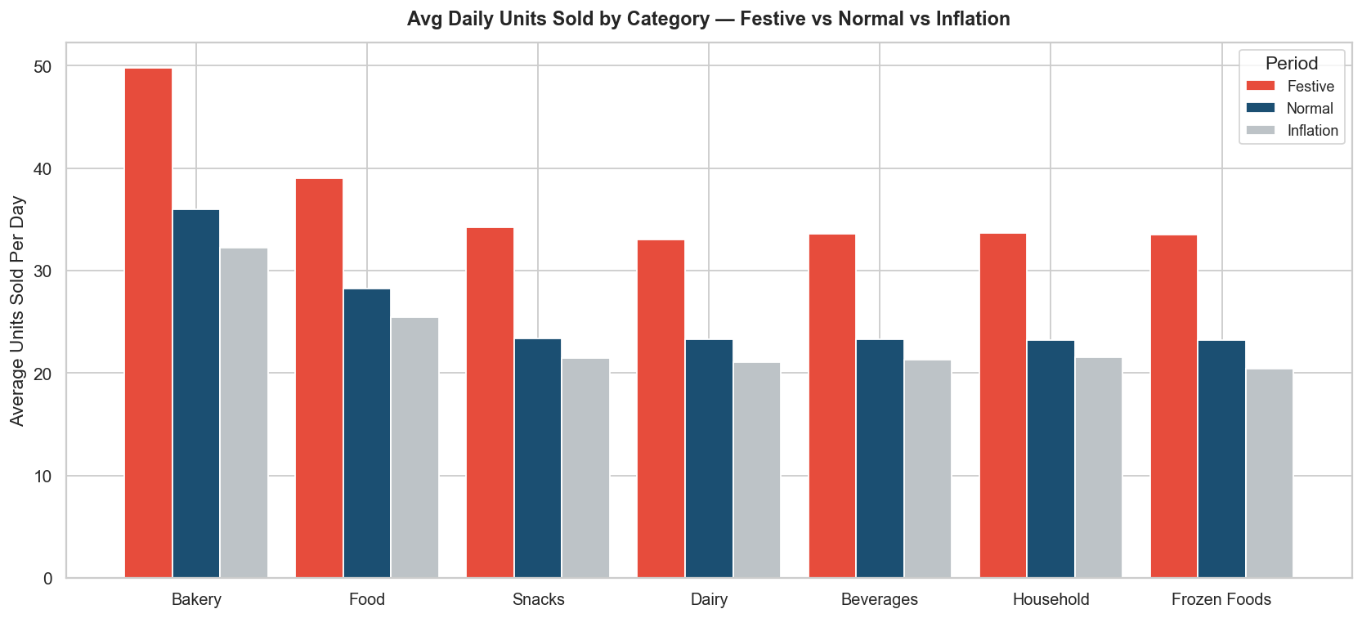
Seasonal Demand Behaviour
+47%
vs normal demand
15-20%
demand reduction across categories
50 units/day
highest festive category
Festive Uplift
Inflation Impact
Bakery Peak

Slide 7
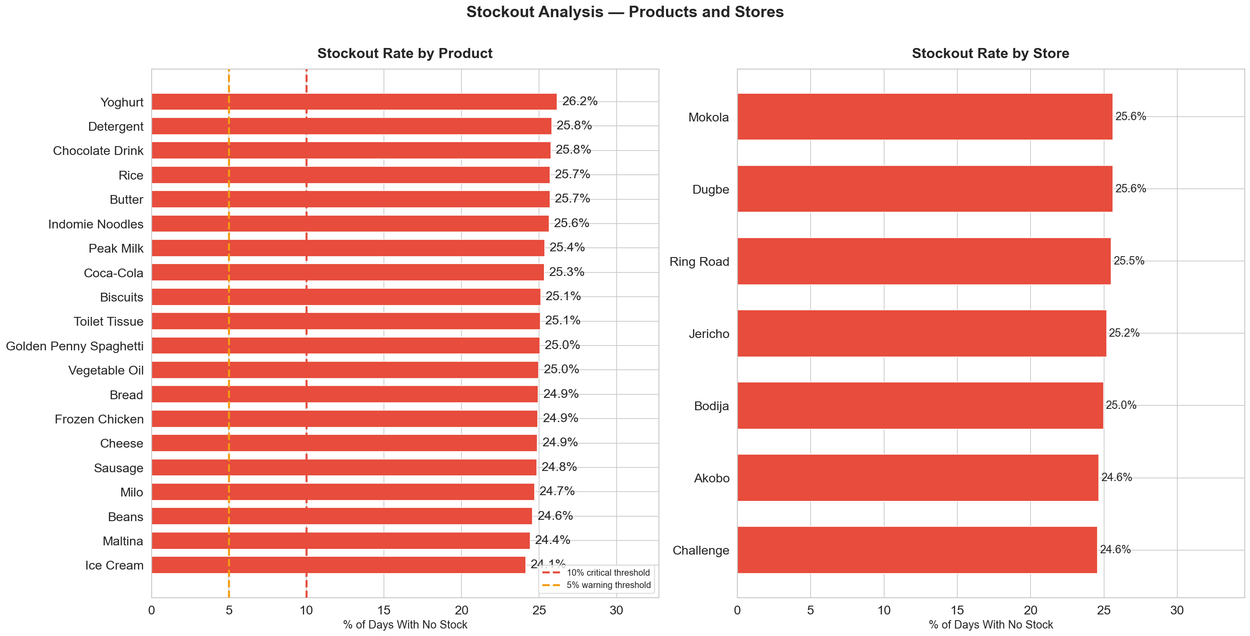
Inventory Risk: Stockout Analysis
19,262
Total stockout events recorded across all 7 stores and all 20 products over 18 months. Every product in the assortment experienced at least one stockout, and stockout rates range from 24% to 26% across the network, indicating a system-wide inventory planning gap rather than isolated product issues.

Slide 8
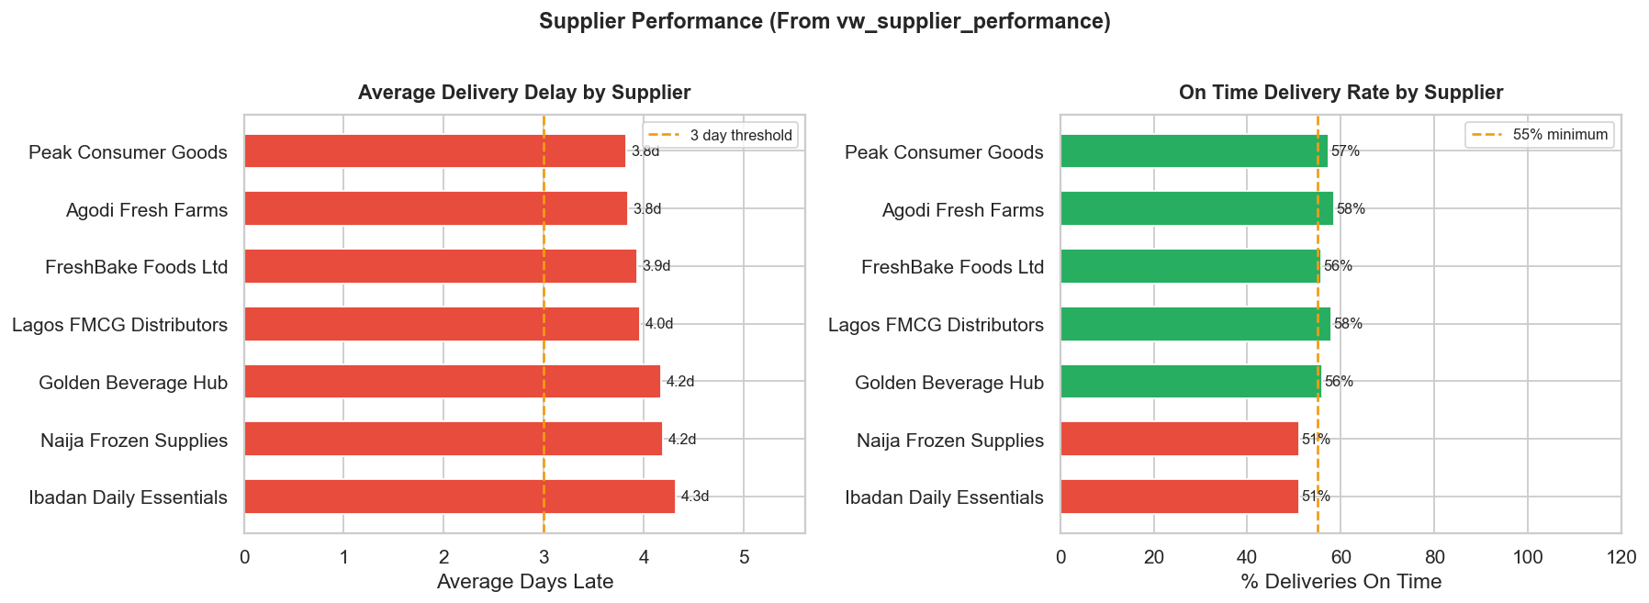
Supplier Performance Assessment
86.1%
4 days
51%
of all deliveries
experienced some delay
average delay
across all suppliers
lowest on-time rate
(Naija Frozen & Ibadan)

Slide 9
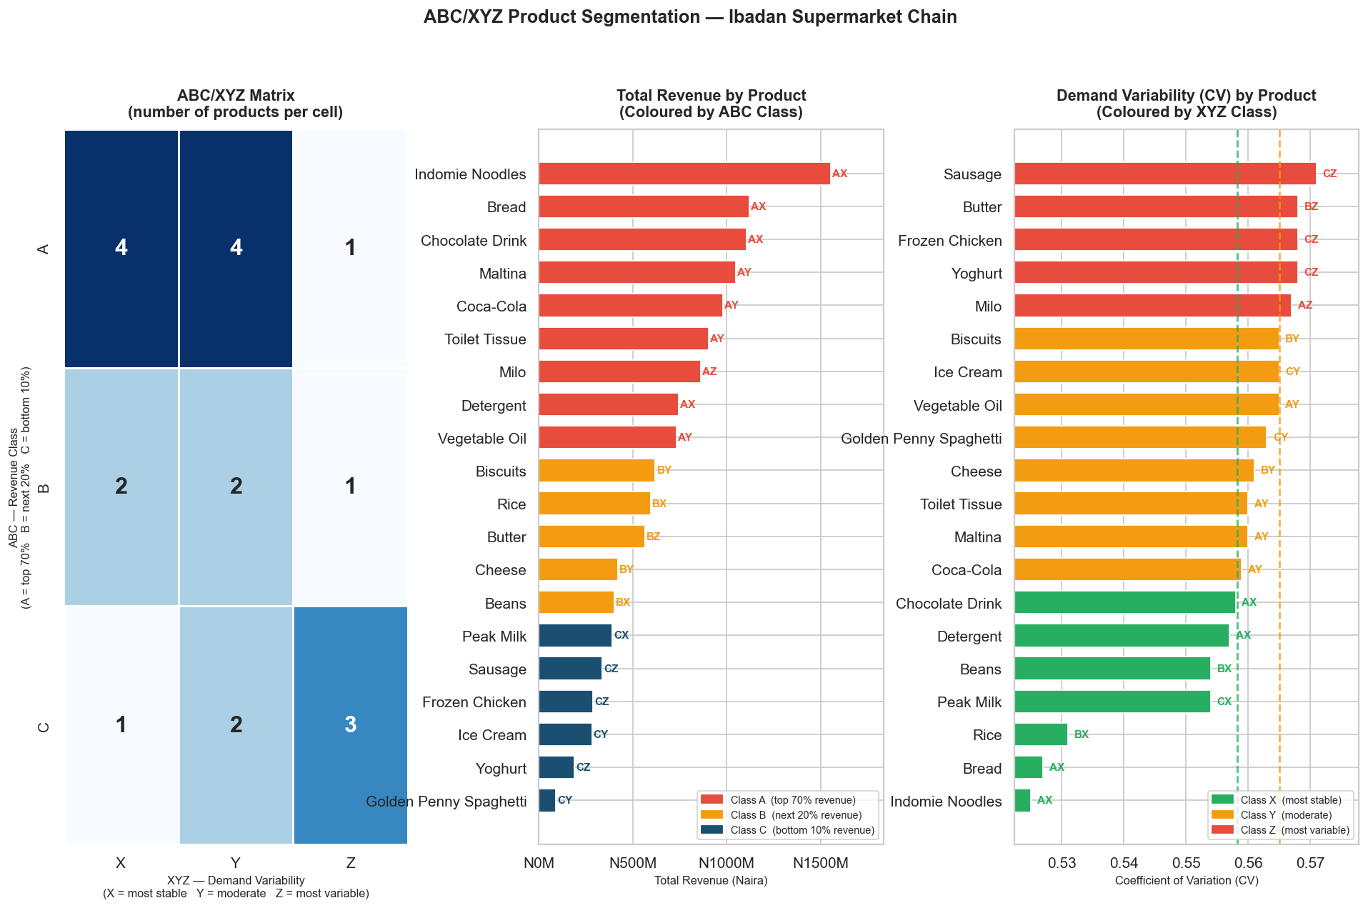
ABC / XYZ Product Segmentation
AX
High revenue, stable demand. Priority planning.
AZ
High revenue, volatile demand. Needs safety stock.
CZ
Low revenue, volatile. Monitor but deprioritise.

Slide 10
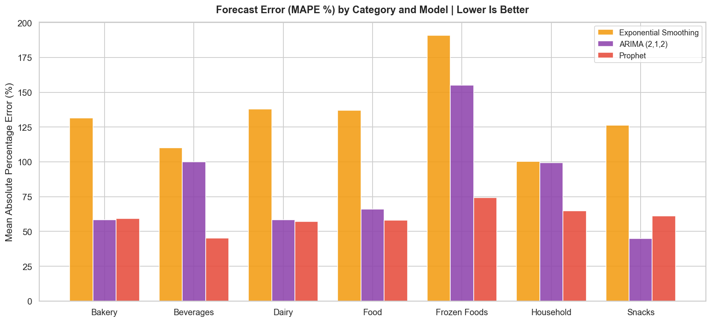
Forecast Model Comparison (MAPE)
WINNER
2nd Place
3rd Place
Prophet
ARIMA (2,1,2)
Exp. Smoothing
Lowest MAPE in 6 of 7 categories. Handles seasonality and holidays natively.
Strong on stable categories. Competitive with Prophet on Bakery.
Consistently highest errors. Fails on trend + seasonal data.

Slide 11
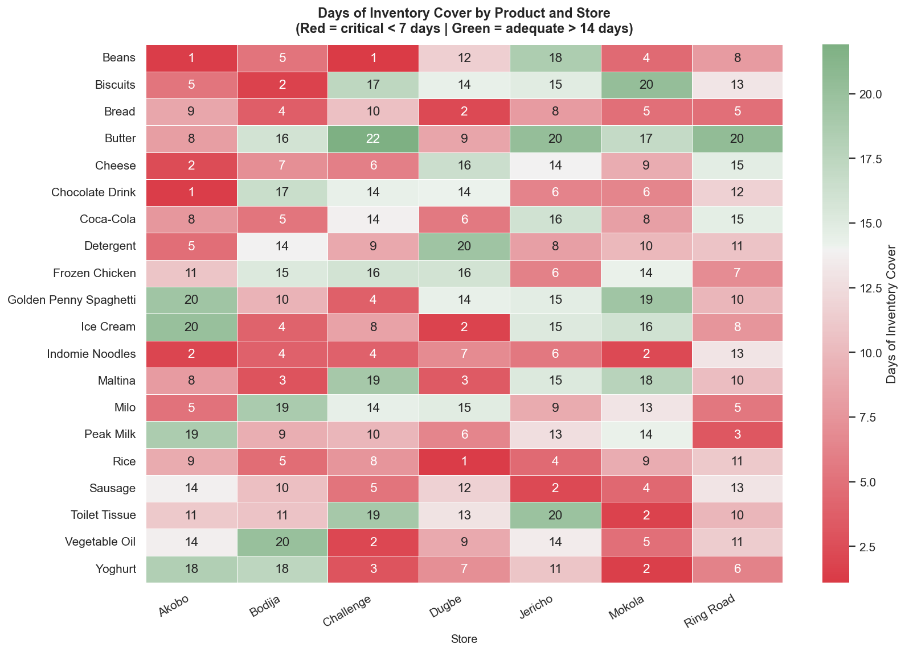
Days of Inventory Cover by Store
Critical under 7 days
Adequate over 14 days
Indomie Noodles, Bread, and Rice are at critical cover levels across multiple stores simultaneously.

Slide 12
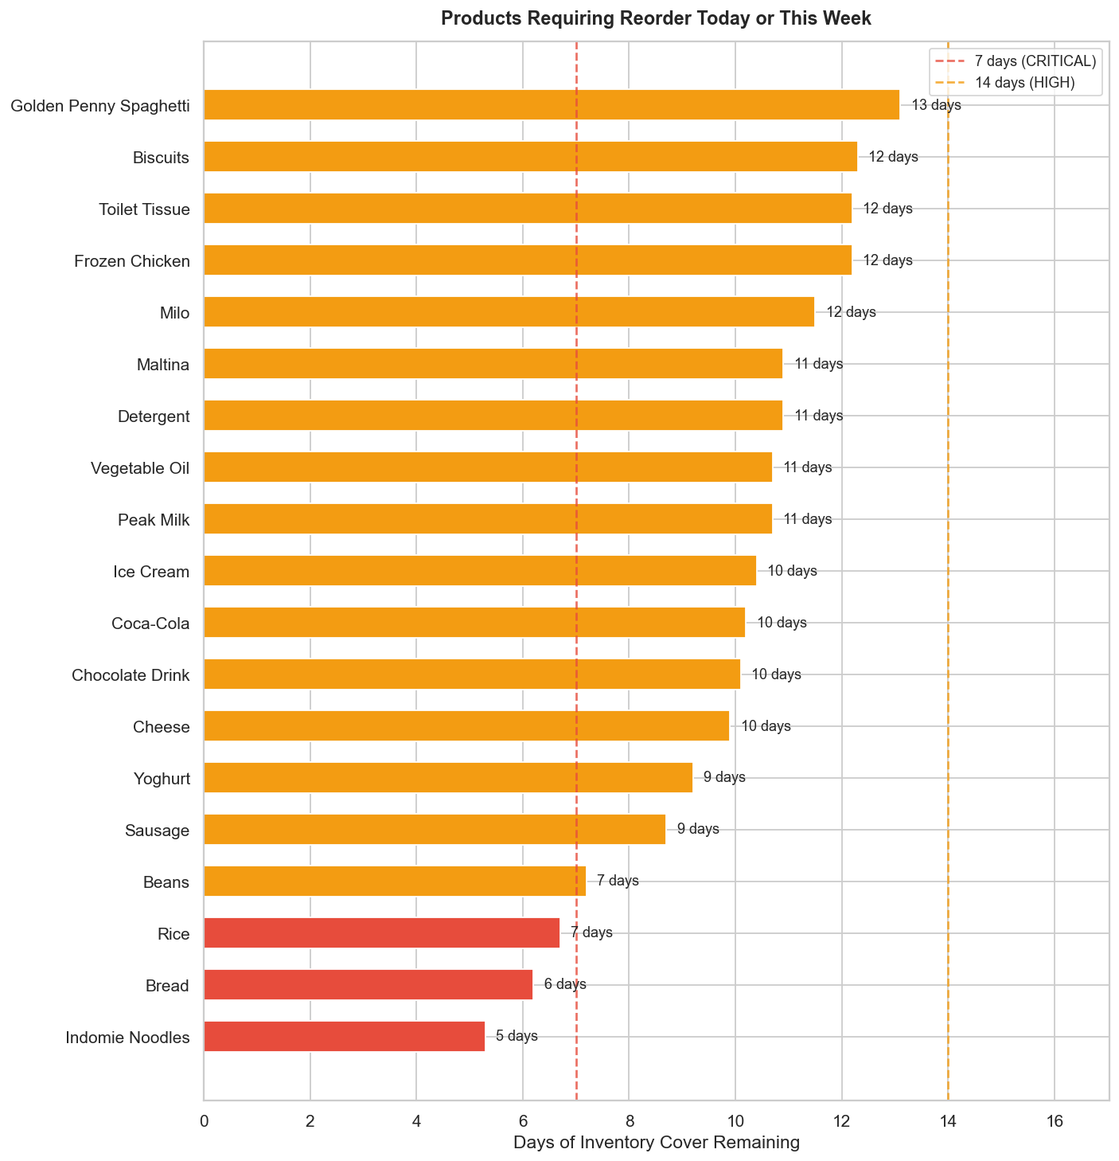
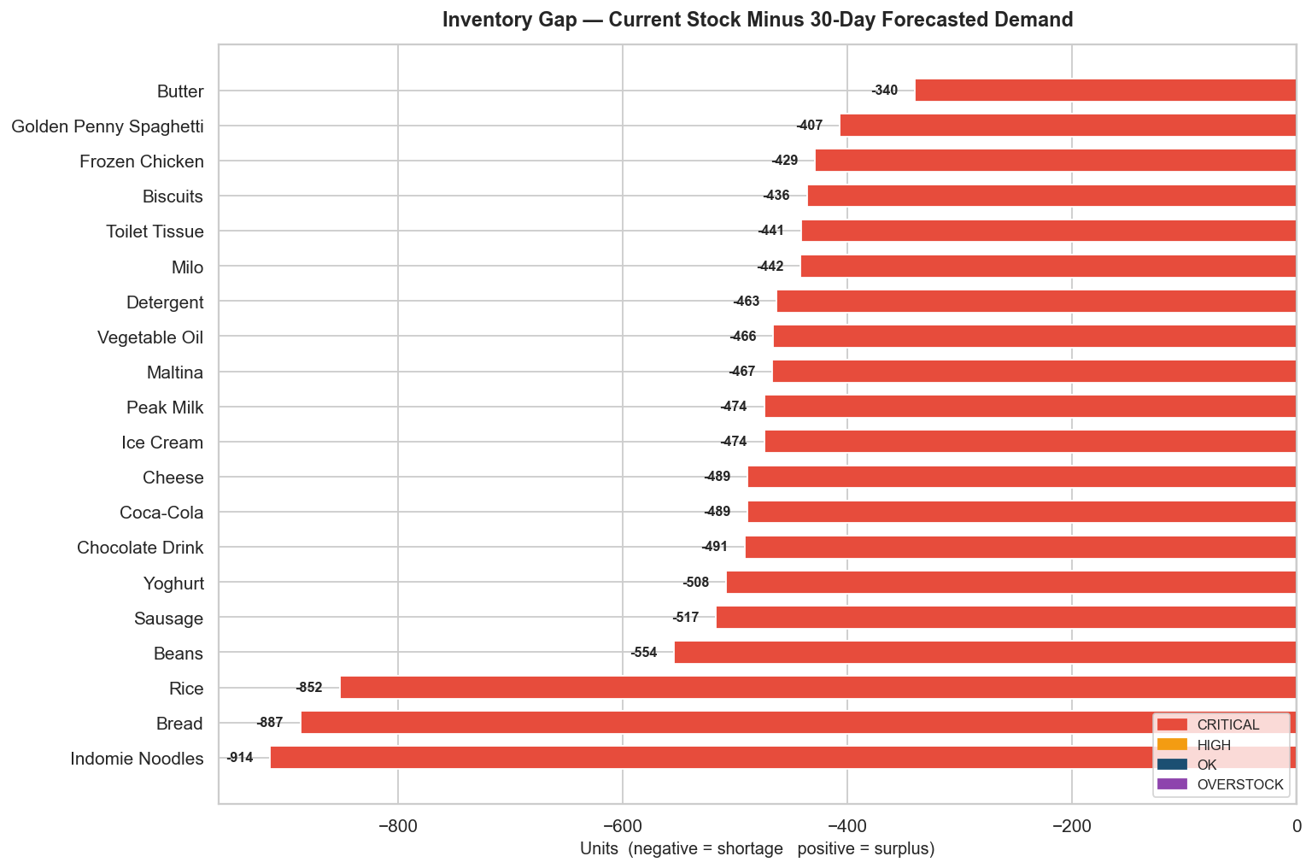
Reorder Urgency & Inventory Gap
All 20 products show negative inventory gaps versus 30-day forecasted demand. Indomie Noodles (-914 units), Bread (-887 units), and Rice (-852 units) face the most severe shortfalls and require immediate replenishment action.

Slide 13
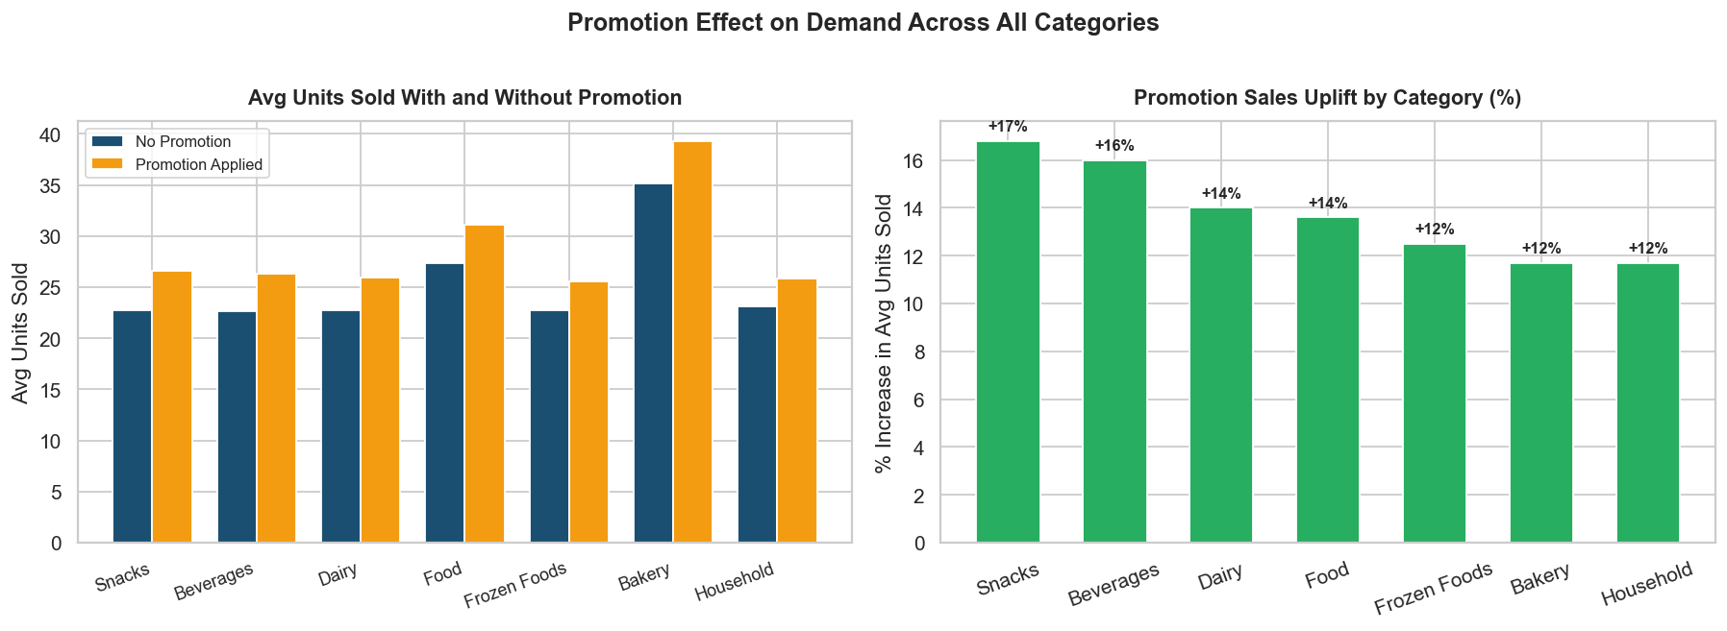
Promotion Impact & Replenishment Efficiency
PROMOTION FINDINGS
+16%
average uplift across all categories during promotions
Bakery
largest absolute increase: +4.1 units per day
100%
of categories show measurable sales increase with promotions
Replenishment implication: promotional periods consistently require 15 to 20% higher inventory allocations. Forecasting models that ignore promotion calendars will systematically understock during these periods.

Slide 14
Key Findings
01
Demand Is Highly Variable
02
April & December Drive Peaks
Every product category exceeds 50% demand variability. Bread, Indomie Noodles, and Rice combine the highest sales volumes with the largest daily swings, making them the hardest to plan.
Festive periods lift demand by nearly 47% above baseline. Both months appear consistently across both years, confirming these are recurring, predictable events.
03
Stockouts Are Network-Wide
04
Suppliers Delay 86% of Deliveries
19,262 stockout events occurred across all 20 products and all 7 stores. Stockout rates hover around 25% regardless of category or location.
No supplier achieves consistent on-time delivery. Average delays of 4 days across all partners create persistent uncertainty that current replenishment plans do not account for.
05
Prophet Outperforms Other Models
06
Entire Portfolio Faces Stock Shortfalls
Meta Prophet achieved the lowest forecast error in 6 of 7 categories. Its ability to model seasonality and holiday effects makes it the preferred approach for this retail context.
All 20 products show negative inventory gaps relative to 30-day forecasted demand. Indomie Noodles, Bread, and Rice require the most urgent replenishment action.

Slide 15
Recommendations
1
Adopt Prophet for Demand Forecasting
Deploy Meta Prophet as the primary forecasting engine for all seven categories. Its native handling of yearly seasonality and Nigerian public holidays brings error rates significantly below ARIMA and Exponential Smoothing across most categories.
2
Build Seasonal Safety Stock
Pre-position 40 to 50% additional inventory for Bread, Indomie Noodles, Rice, and Bakery products ahead of April and December. Failure to pre-stock these periods results in predictable and avoidable stockouts on the highest-revenue products.
3
Adjust Lead Times for Actual Supplier Performance
Replace planned delivery dates with empirical lead times that add 4 to 5 buffer days to every supplier order. Reorder points must reflect that 86% of deliveries arrive late, not on schedule.
4
Priority Replenishment for Critical SKUs
Indomie Noodles, Bread, and Rice are simultaneously at critical inventory cover levels across multiple stores. These three products represent the highest-value stockout risk in the network and require immediate restocking action.

Slide 16
Thank You
Tool: PostgreSQL + Python
Data: 76,580 transaction records
This project analysed 18 months of transaction data across 7 FoodMart stores and 20 products in Ibadan, Nigeria. The analysis covers demand behaviour, stockout patterns, supplier reliability, seasonal effects, and product segmentation.
Forecast modelling using ARIMA, Exponential Smoothing, and Prophet demonstrates that data-driven inventory planning can substantially reduce the 19,262 stockout events observed during the analysis period.
Period: January 2024 to June 2025
Coverage: 7 stores, 20 products, 7 suppliers
Olajimi Adeleke
Data Analyst | Portfolio Project | PostgreSQL & Python

